Slide 1
SEMINAR IMAGE DETECTION AND DEEP LEARNING
By
Prathmesh N. Adsod
Guided by
Prof. A. B. Parandekar

Slide 2



Seminar
“Image Detection and Deep Learning”
IS SUBMITTED TO
SANT GADGE BABA AMRAVATI UNIVERSITY
IN THE PARTIAL FULFILLMENT OF THE DEGREE OF
BACHELORS OF ENGINEERING
IN
INFORMATION TECHNOLOGY
BY
Mr. Prathmesh N. Adsod
GUIDED BY
Prof. A. B. Parandekar
DEPARTMENT OF INFORMATION TECHNOLOGY
SIPNA COLLEGE OF ENGINEERING AND TECHNOLOGY, AMRAVATI
(AN ISO 9001:2015 CERTIFIED INSTITUTE)
SANT GADGE BABA AMRAVATI UNIVERSITY, AMRAVATI
2022-2023

Slide 3
Topics to Cover -
Introduction
ML vs Deep Learning
Architecture flow chart
How Deep Learning works
Deep Learning in Image Detection
Hardware Requirements
Applications
How to create and train models
Tensorflow for Deep Learning
Conclusion

Slide 4
INTRODUCTION
AI is superset of ML , which is superset of Deep Learning
Deep learning goes beyond ML by creating more complex hierarchical models that are meant to mimic how humans learn new information
Deep learning is a subset of ML, which is essentially a neural network with three or more layers
These neural networks attempt to simulate the behavior of the human brain—albeit far from matching its ability—allowing it to “learn” from large amounts of data .

Slide 5
While a neural network with a single layer can still make approximate predictions, additional hidden layers can help to optimize and refine for accuracy
Where Deep Learning ?
- Automation
- No need of Human Intervention
- Natural Language Processing
- Image Detection
. Examples –
- Amazon Alexa , Apples Siri
- Self Driving Cars
- Chatbots
- Google Translation
- Auto-complete feature

Slide 6
In deep learning, a computer model learns to perform classification tasks directly from images, text, or sound.
RNN is used for Natural Language Processing and CNN is used for Image Detection.
We have different tools for implementing deep learning like Tensorflow , Keras , Scikit-Learn , PyTorch etc.

Slide 7
ML VS Deep Learning
Machine Learning
Deep Learning
The data is different as compared to Deep Learning as it uses mostly structured data
consists of thousands of data points.
Outputs: Numerical Value, like classification of the score.
The data is different as it uses neural networks(ANN).
Big Data: Millions of data points.
Anything from numerical values to free-form elements, such as free text and sound.

Slide 8
Training can be performed using the CPU (Central Processing Unit).
More human intervention is involved for getting results.
Its model takes less time in training due to its small size.
Humans explicitly do feature engineering.
Random Forest , KNN , K-Means , Naïve-Bayes Algo
A dedicated GPU (Graphics Processing Unit) is required for training.
Although more difficult to set up, deep learning requires less intervention once it is running.
A huge amount of time is taken becausee of very big data points.
Feature engineering is not needed because important features are automatically detected by neural networks.
ANN , RNN , CNN , LSTM

Slide 9
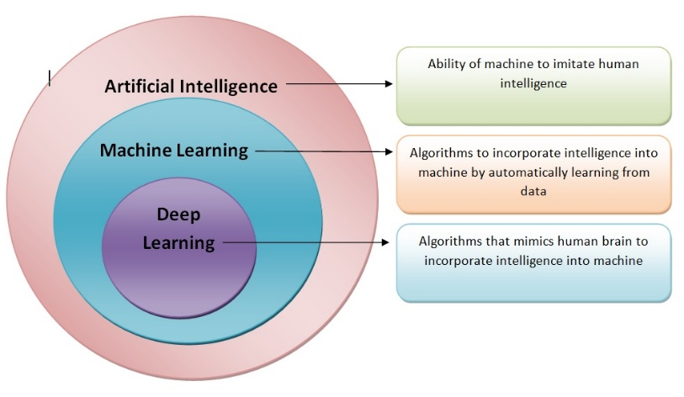
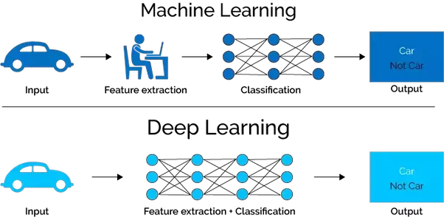

Slide 10
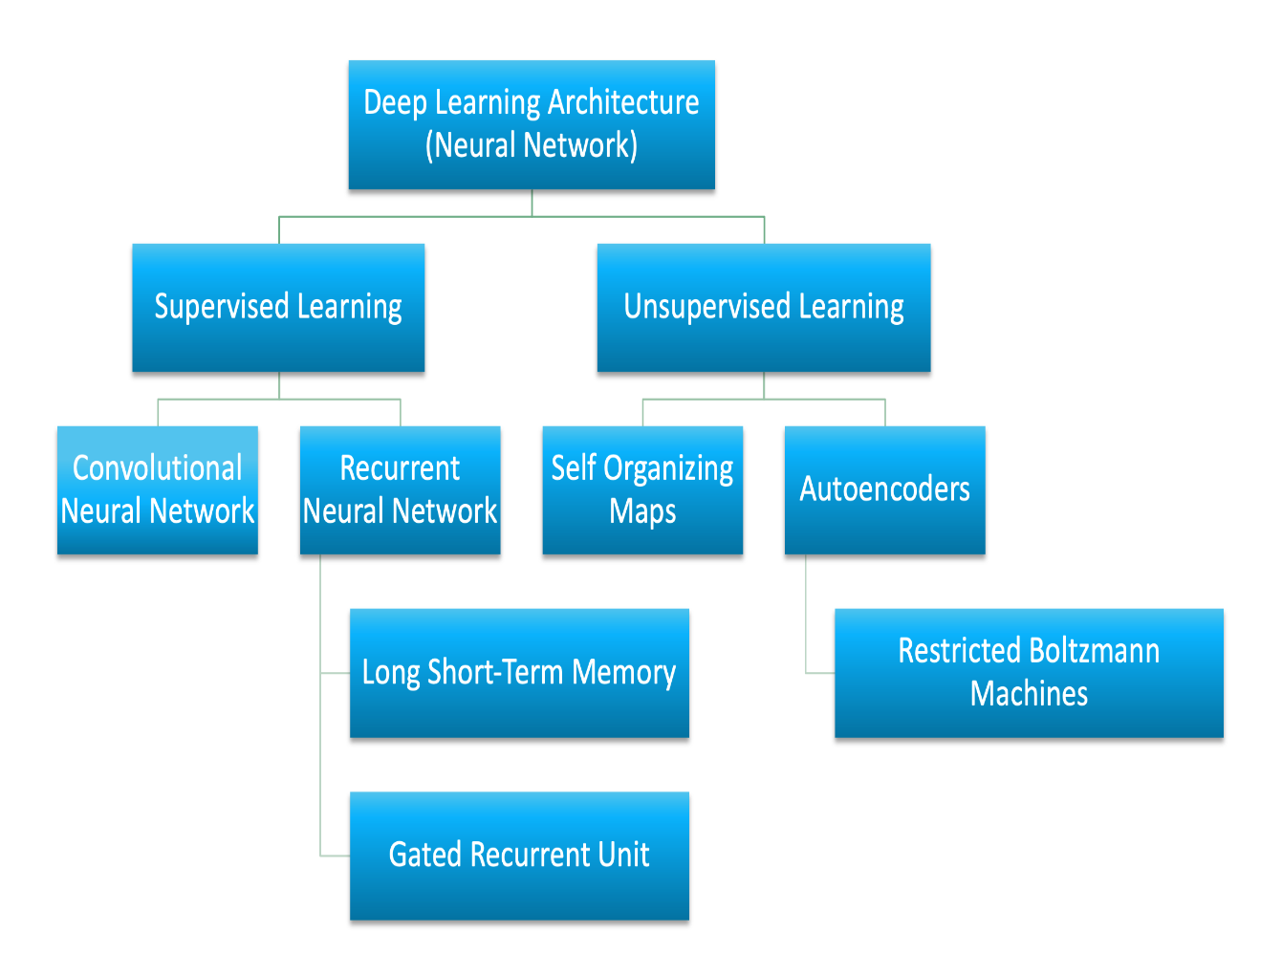
Architecture flow chart

Slide 11
How Deep Learning works
Deep neural networks consist of multiple layers of interconnected nodes
each building upon the previous layer to refine and optimize the prediction or categorization
The input and output layers of a deep neural network are called visible layers.
The input layer is where the deep learning model ingests the data for processing
the output layer is where the final prediction or classification is made

Slide 12
However, deep learning algorithms are incredibly complex, and there are different types of neural networks to address specific problems or datasets
There are hidden layer present between input layer and output layer
CNN - used primarily in computer vision and image classification applications, can detect features and patterns within an image, enabling tasks, like object detection or recognition.
RNN - are typically used in natural language and speech recognition applications as it leverages sequential or times series data.

Slide 13
“Deep” refers to the many layers the neural network accumulates over time, with performance improving as the network gets deeper.
Each level of the network processes its input data in a specific way, which then informs the next layer.
So the output from one layer becomes the input for the next.
Training deep learning networks is time consuming and requires large amounts of data to be ingested and tested against as the system gradually refines its model

Slide 14
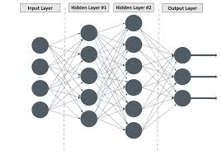
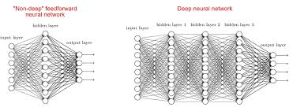

Slide 15
Deep Learning in Image Detection
Convolution Neural Network CNN is used for Image Detection.
So, to be able to recognize images, a system must learn their features first.
It must be trained to predict whether an object is X or Z.
Deep learning models learn these characteristics in a different way from machine learning (ML) models.
Each layer of nodes trains on the output (feature set) produced by the previous layer.

Slide 16
So, nodes in each successive layer can recognize more complex, detailed features – visual
Such a heirarchy of increasing complexity and abstraction” is known as feature hierarchy.
Layers used to build CNN
A CNN is a sequence of layers, and every layer transforms one volume to another through a differentiable function.
Types of layers: Let’s take an example by running a CNN on of image of dimension 32 x 32 x 3.
Input Layer:
This layer holds the raw input of the image with width 32, height 32, and depth 3.
Convolution Layer
This layer computes the output volume by computing the dot product between all filters and image patches. Suppose we use a total of 12 filters for this layer we’ll get output volume of dimension 32 x 32 x 12.

Slide 17
Activation Function Layer
This layer will apply an element-wise activation function to the output of the convolution layer. Some common activation functions are RELU: max(0, x), Sigmoid: 1/(1+e^-x), Tanh, Leaky RELU, etc. The volume remains unchanged hence output volume will have dimension 32 x 32 x 12.
Pool Layer
This layer is periodically inserted in the CNN and its main function is to reduce the size of volume which makes the computation fast reduces memory and also prevents overfitting. Two common types of pooling layers are max pooling and average pooling. If we use a max pool with 2 x 2 filters and stride 2, the resultant volume will be of dimension 16x16x12.
Fully-Connected Layer
This layer is a regular neural network layer that takes input from the previous layer and computes the class scores and outputs the equal to the number of classes. 1-D array of size. They will assign a probability for the object on the image being what the algorithm predicts it is.

Slide 18
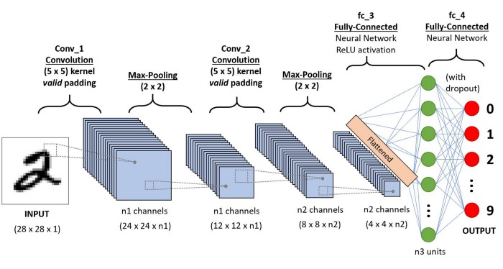

Slide 19
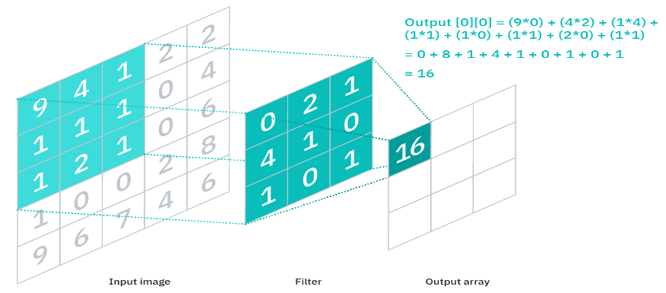
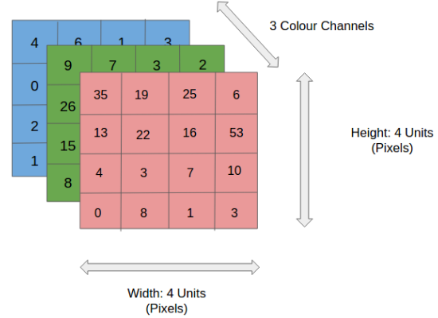
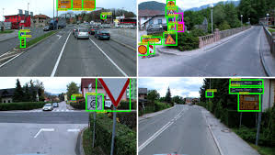
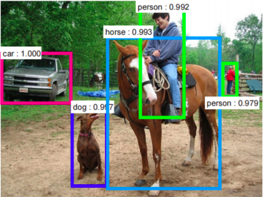

Slide 20
Hardware requirements
Minimum Hardware Requirements –
GRAPHICS CARD:- 1650 or 1660TI
CPU:- i5 9th or 10th Gen.
RAM:- 16GB
Deep Learning do lot of computational tasks so we need good RAM , ROM , Procesors , CPU’s and GPU’s etc.

Slide 21
Applications
Traffic Sign Recognition
Automation
Law Enforcement
Healthcare
Translation
Voice Assistance
Image / Object Detection
Autocomplete

Slide 22
How to Create and Train Deep Learning Models
Training from Scratch
Transfer Learning
Feature Extraction

Slide 23
Deep Learning with Tensorflow
TensorFlow is a framework created by Google for creating Deep Learning models
Machine Learning has enabled us to build complex applications with great accuracy. Whether it has to do with images, videos, text or even audio, Machine Learning can solve problems from a wide range. Tensorflow can be used to achieve all of these applications.
The human brain consists of billions of neurons which are interconnected by synapses. If “enough” synaptic inputs to the neuron fires, then the neuron will also fire. This process is called thinking. To replicate that process on computers, we need machine learning and neural networks.

Slide 24
Tensorflow was created with processing power limitations in mind.
The framework can be ran on computers of all kinds, even on smartphones (yes, even on that overpriced thing with half an apple on it). Working on a Intel Core i3 with 8 GB of RAM, you won’t have performance issues.

Slide 25
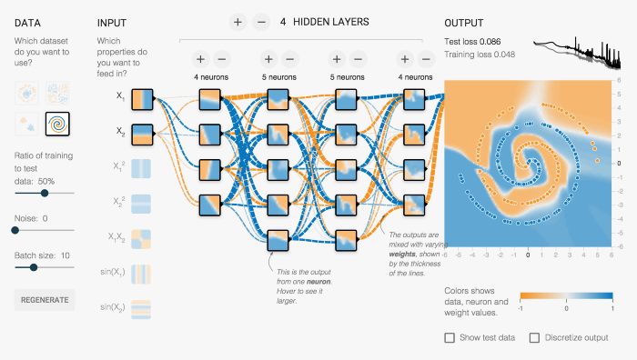

Slide 26
Conclusion
By this way we got covered how we are using deep learning in our project . Traffic sign detection is one of the good way to study CNN and deep learning . By this way we learn how our CNN algorithm will directly digest the images and we do not need to pre-process data. We have learnt how deep learning work internally and got idea about how our model will be working in this process .We also got idea about different layers in cnn.
We have taken different different use cases to know more about Deep Learning and learnt about how layer by layer our model gets build . We also covered deep learning and machine learning difference.

Slide 27
Thank You

